Slide 1



AIME 2019
Artificial Intelligence in Medicine
Poznan Conference review

Slide 2

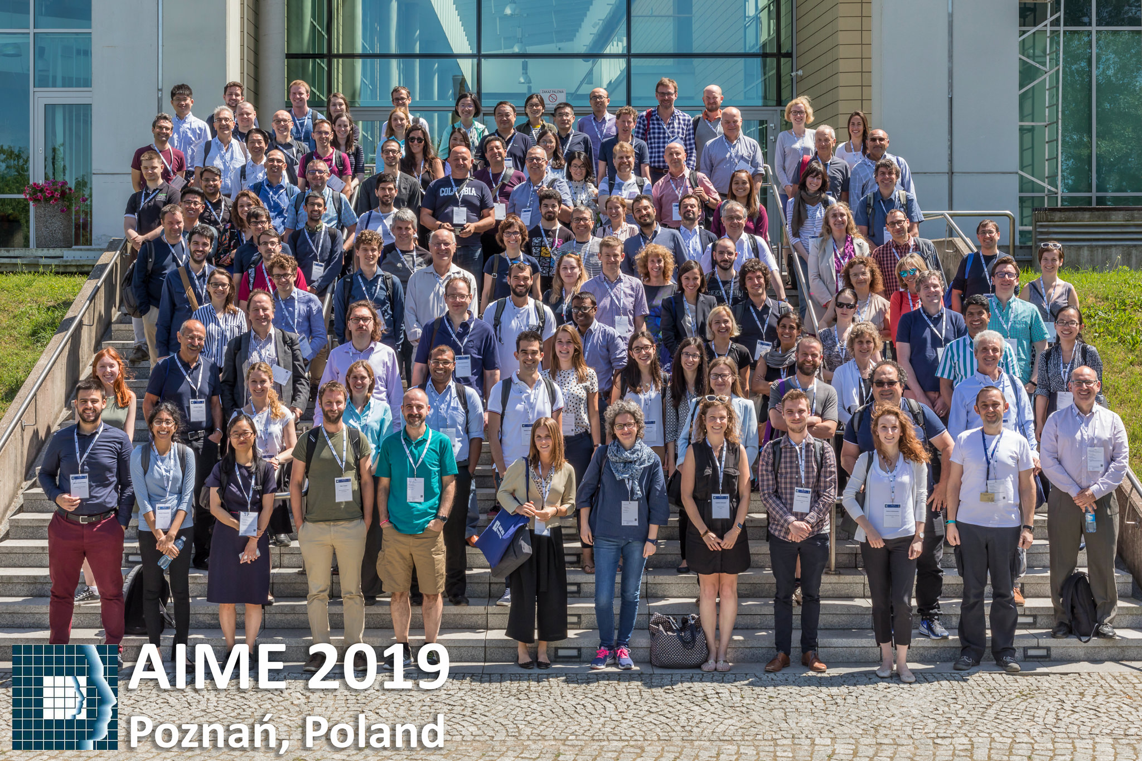

Agenda
Conference information
Tutorials
Keynotes
Brief papers overview
Selected paper review
Where is Ephy?

Slide 3
Conference information
Small conference – 150 participants, 70 in tutorials
Once in every 2 years
~160 submitted papers ~40% accepted
Most papers from US, UK, Italy
More accepted papers from US than US participants
Both keynote presentations were done on Skype

Slide 4

Tutorials
Evaluation of predication models
Argumentation – Anomaly explanation in ICU
Workshop in Explainability
Notes:
Evaluation of predication models – very basic, some performance measurements AUC, calibration graph
Argumentation – implemented in ICU, gives arguments to physician to explain phenomenal
Workshop – lectulere from Germany – digital wearable – unified holistic feature embedding space for different problems – why, more interesting for publishing. The others were less impressive

Slide 5
Argumentation tutorial
The Process of reasoning systematically in support of an idea/action/theory by computer
Example: Adrenalin should increase heart rate
Patient received Adrenalin and HR wasn’t increased
Business cases: provide explanations to anomaly in ICU and improve physician care
Detection of the anomaly based on DB of facts and rules system – pyknow (python library)
Explain the anomaly - with ability for the doctor to add more arguments till all conflicts resolved
Multiple system organ failure
Adrenalin just doesn’t work
Doctor: the HR did increase…
Notes:
multiple system organ failure – The kidney and liver function decreased with some other measurements..
Important specially for junior doctors..

Slide 6
Keynotes
Data Scientist & Physician & Gentleman (“Coby”) – Wrong conceptions:
AI to every aspect of healthcare / AI to replace the doctor
Physician does cognitive and creative thinking – physiology is more cognitive
Physician does science and fact thinking – More suitable for ML
Problems with “small” cohorts
Empathy
Deep learning is the king – wrong in EHR data. More complicate AI has less acceptance
Doctors prefer PPV-Recall VS ROC
AI is Blackbox
Many complicated healthcare devices are practically “black boxes” and gets physician trust – need to be proven and accurate!
Explainability
Magnitude depends on the practice

Slide 7

Brief papers overview
Medication guideline safety
LSTM for EHR
EEG abnormality – neural net engineering
Mammogram classification in ordered loss – equivalent to simple weights
A Critical Look at Studies Applying Over-Sampling on the TPEHGDB Dataset
Effectiveness of sequences treatments using sequential patterns – subsequence events statistics on outcome
Explainers – LIME, use of python\R packages
Pathology Laboratory utilization – over\under lab results
Using Cluster Ensembles to Identify Psychiatric Patient Subgroups – several clustering +voting
Identification of Patient Prescribing Predicting Cancer Diagnosis Using Boosted Decision Trees
Adverse effect of drugs from social media – NLP
Interpretable Patient Subgrouping Using Trace-Based Clustering – similar patient’s conditions=>clustering=>outcome/treatment in clusters
Fully Interactive Lungs Auscultation with AI Enabled Digital Stethoscope
Oversampling before split to train/test!
UK – lung cancer 0.73 AUC
Notes:
Someone have shown AUC of 0.999 – by quick calculation it’s 2 falses in the 100% sensitivity.

Slide 8
Gated Hidden Markov Models for Early Prediction of Outcome of ICBT
Best Student paper
ICBT = Internet-based Cognitive Behavioral Therapy – for depression
Goal: identify individual the therapy doesn’t work. Trade of between predict time ⬄ accuracy
HMM – interpretable probalistic model, can incorporate prior knowledge, maybe more suitable to catch stochastic dynamics in states
Idea: Incorporate domain knowledge as “gate” to zero impossible states

Slide 9
ICBT Dataset
2076 individuals
Each tracked for 13 weeks each week
Each week 9 questions with values 0-6 for depression

Slide 10
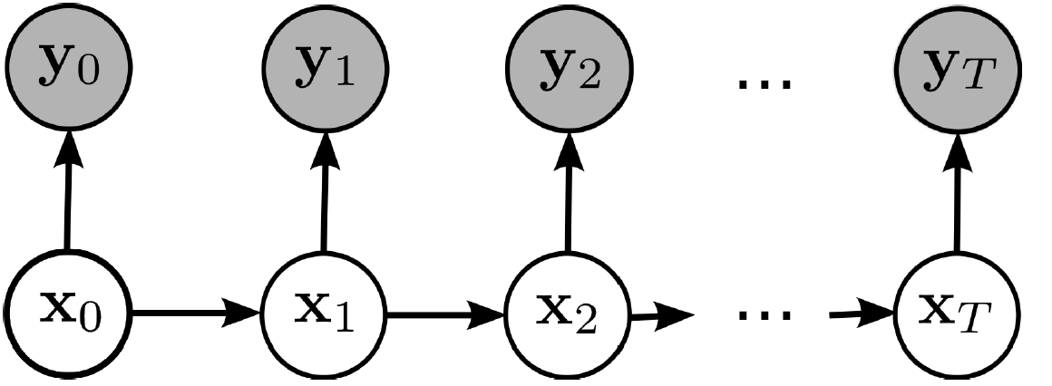
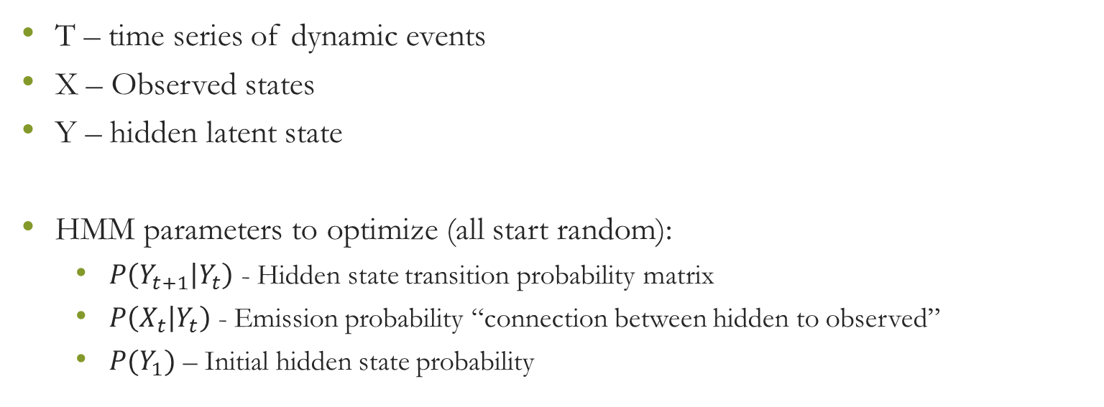
HMM
T – time series of dynamic events
X – Observed states
Y – hidden latent state
HMM parameters to optimize (all start random):
$P\left(Y_{t+1} | Y_{t}\right)$ - Hidden state transition probability matrix
$P\left(X_{t} | Y_{t}\right)$ - Emission probability “connection between hidden to observed”
$P(Y_{1})$ – Initial hidden state probability

Slide 11
HMM - Solution
EM Algorithm – 2 iterative steps (Baum–Welch algorithm) for each data row:
E-step: with current HMM parameters, calculate probability of hidden states “expected values” for each time point
M-step: with current dynamic of hidden states, calculate probability tables again to optimize maximum likelihood
With model params estimate the probabilities of hidden states in each time
After we “know” the hidden states probabilities, update the HMM params to maximize the likelihood for the dynamics

Slide 12
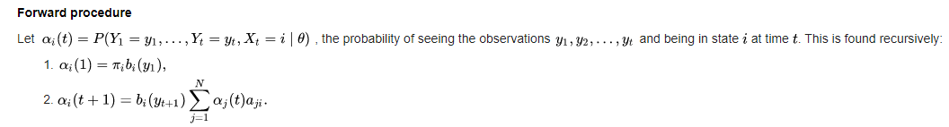
Baum–Welch algorithm
A – transition matrix, B-emission matrix, Y-Observed, X-hidden
The probability hidden state is i at time t, current HMM params - dynamic programing, use conditional prob on all possible values from previous step

Slide 13
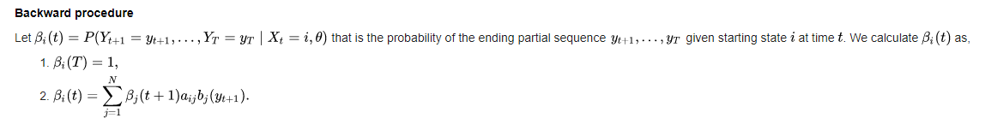
Cont
Dynamic programing from the end till time t
After having all probs for hidden states in each time point – update HMM params using those probs

Slide 14
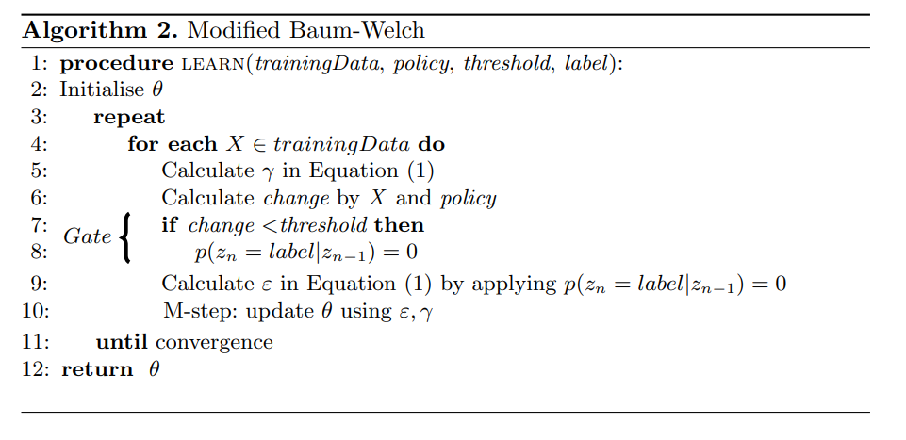
Gated HMM
Policy – Domain expert rule. Defined here by “change”

Slide 15
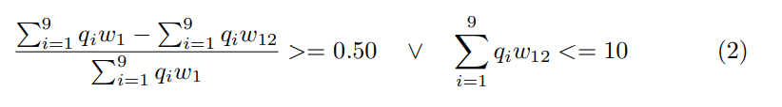
Application on ICBT
1 latent binary variable: treatment is successful or not
Labeling rule:
Selected policy: calculate fractional change till current time point, threshold 0.5
If doesn’t hold – latent state “success” is set to 0 probability
9 questions marked as $q_{i}w_{j}$ - question i in week j

Slide 16
Discussion
Setting the policy very similar to the “real” outcome labeling – not sure it’s OK

Slide 17
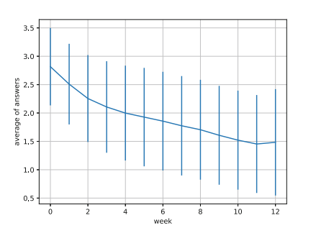
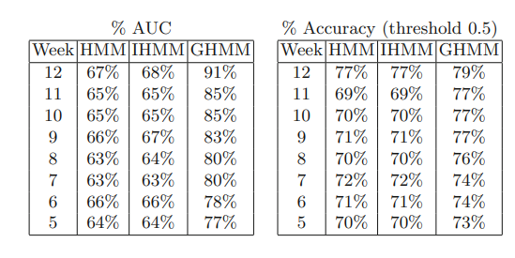
Results
On average decrease of 50% (maybe that’s the threshold criteria)
GHHM is much better on each time window. Threshold in accuracy should be selected better

Slide 18
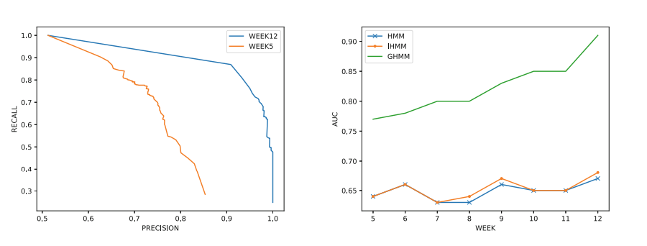
Results on graphs

Slide 19
Thanks
All papers from AIME 2019 can be found here:
External: P:\Conferneces\AIME_2019
Internal: W:\Conferences\AIME_2019\pdfs
Wikipage (Internal): http://confluence:8090/display/WIK/AIME+2019

